Slide 1
Liceul Tehnologic “Mihai Eminescu” Slobozia
SISTEMUL EXCRETOR LA MAMIFERE
PROF. NOVAC MIHAELA

Slide 2
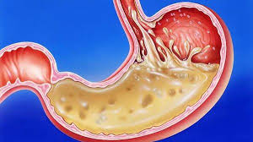
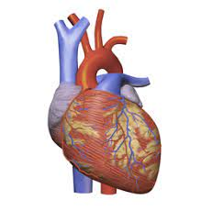
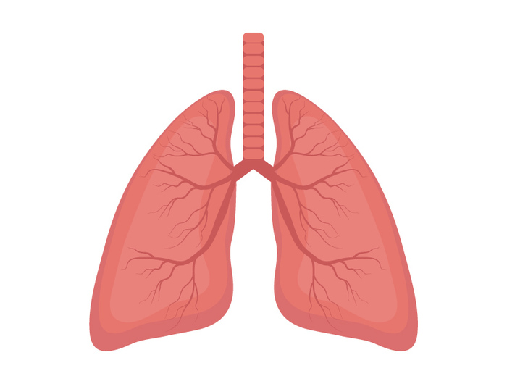
ORGANE CARE PARTICIPĂ LA REALIZAREA FUNCȚIILOR DE NUTRIȚIE

Slide 4
ZONA CORTICALĂ

Slide 5
ZONA MEDULARĂ

Slide 6
PIRAMIDELE MALPIGHI

Slide 7
BIBLIOGRAFIE
https://encrypted-tbn0.gstatic.com/images?q=tbn:ANd9GcQApN0Q1w05xA6TZxYy7aY0hrR9gRQdE9ADGw&usqp=CAU
https://www.reginamaria.ro/sites/default/files/articol/2019%3A08/21ziua_plamanilor.jpg
https://www.google.com/url?sa=i&url=https%3A%2F%2Fro.wikipedia.org%2Fwiki%2FInim%25C4%2583&psig=AOvVaw2W39QWjlhjEui64Yfkngh8&ust=1647289517903000&source=images&cd=vfe&ved=0CAsQjRxqFwoTCLCn5-b1w_YCFQAAAAAdAAAAABAK

